Slide 1
Putting History on the Map
Ami Kano, Chunru Zheng, Rachel Grace Treene

Slide 2
Our Client: OneSharedStory
One Shared Story connects families to their ancestry. Specifically, they help the African American community gain insight into their ancestry prior to emancipation.
Minorities and women struggle to trace ancestry because Census (and other government records) only tracked the names of free adult males before 1870Census.
OneSharedStory wants to identify and make available Property Tax Records that can be used to identify these “hidden” stories.
They have volunteers transcribe data into standardized spreadsheets and hope we can create a database for storage, a dashboard for interactive search, and pipeline for future entries.

Slide 3
Our Tasks
1. Choose the type of database
Non-relational vs. Relational
2. Design database
Structure data if using a relational database
Relationships: one to many, one to many, many to many
3. Implement database and pipeline
4. Implement search platform
People accessing the data could be searching by surname, first name, date, location.
Searchers will be people looking for documents (historians) and people looking for people (relatives)

Slide 4
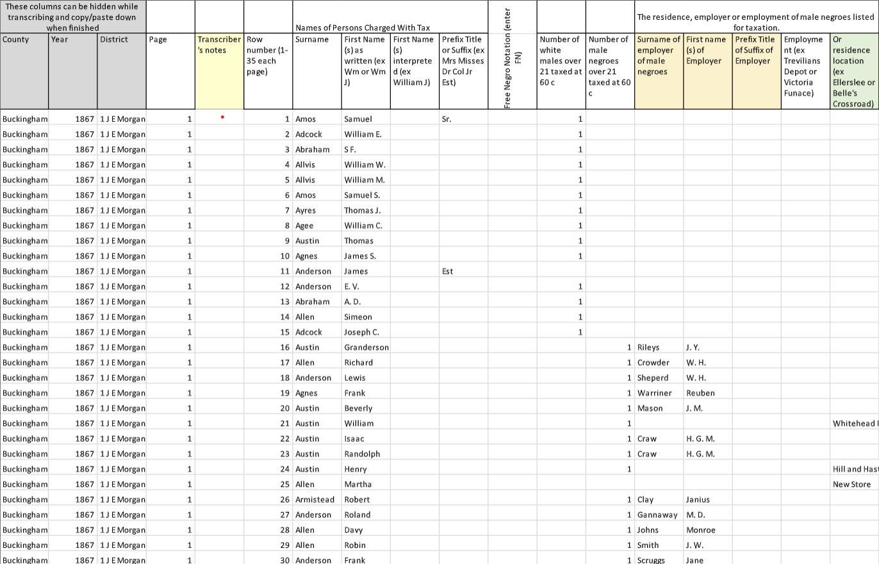
Data Set
Our data comes from historical documents, such as personal property tax records and church records.
Our client has been investigating ways to best organize and combine information
Previously, they had interns manually type in the information from the historical documents into spreadsheets
This is unstructured data
The providers of the historical documents (libraries, churches) wish that they be able to retain rights/ownership of document

Slide 5
Tools and Software
Some sort of SQL
Most likely MySQL or NoSQL
phpMyAdmin
Software tool for administrating SQL
Available for free on client's website
Client requires a free solution for database hosting

Slide 6
Metric of Success
Design and creation of Database and pipeline, by or before the end of the Spring semester
Perhaps a demo database/dashboard in 3 weeks ~ 1 month?

Slide 7
Questions?

